Slide 1
Introduction to SQL Server R Services in SQL 2016
Chris Hyde, Owner and Principal Consultant, Hydrate Consulting LLC

Slide 2
Please silence cell phones

Slide 3


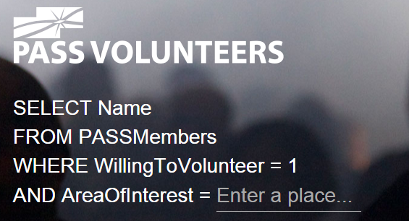





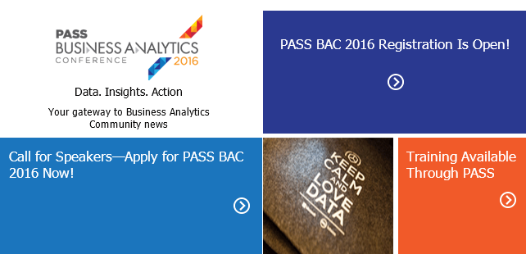



Explore Everything PASS Has to Offer
FREE ONLINE WEBINAR EVENTS
FREE 1-DAY LOCAL TRAINING EVENTS
VOLUNTEERING OPPORTUNITIES
LOCAL USER GROUPS AROUND THE WORLD
ONLINE SPECIAL INTEREST USER GROUPS
PASS COMMUNITY NEWSLETTER
FREE ONLINE RESOURCES
BUSINESS ANALYTICS TRAINING
BA INSIGHTS NEWSLETTER

Slide 4
Session Evaluations
ways to access
3
Your feedback is important and valuable.
Submit by 5pm
Friday November 6th to WIN prizes
Go to passSummit.com
Download the GuideBook App and search: PASS Summit 2016
Follow the QR code link displayed on session signage throughout the conference venue and in the program guide

Slide 5

Chris Hyde Owner and Principal Consultant, Hydrate Consulting LLC
Place your photo here
Independent BI and DBA Consultant with over 16 years of SQL Server experience
Chapter leader of Albuquerque SSUG
Loves cricket and loud music, but not usually at the same time.
@ChrisHyde325

Slide 6

Before we begin…

Slide 7
What is this R you speak of?
“R is a language and environment for statistical computing and graphics.”
“R provides a wide variety of statistical and graphical techniques, and is highly extensible.”
“Many users think of R as a statistics system. We prefer to think of it of an environment within which statistical techniques are implemented.”
Source: https://www.r-project.org/about.com

Slide 8
You got R in my SQL! No, you got SQL in my R!
Microsoft purchased Revolution Analytics in April 2015.
Revolution’s distribution of R was integrated in SQL Server 2016 under the name of SQL Server R Services.
First available in CTP 3.0.

Slide 9
Predicting Free Disk Space
Demo #1

Slide 10
Why R?
Microsoft is positioning itself to be a leader in the field of Business Analytics.
Descriptive Analytics – what has already happened; traditional Business Intelligence
Predictive Analytics – what will happen in the future; data mining, predictive modeling
Prescriptive Analytics – suggesting actions based on the predictive models; the next data science buzzword?

Slide 11
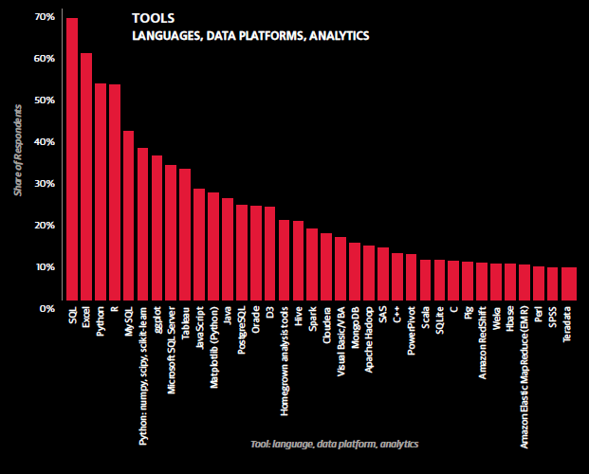
R as an Analytics Tool
Source: O’Reilly Data Science Survey 2015

Slide 12
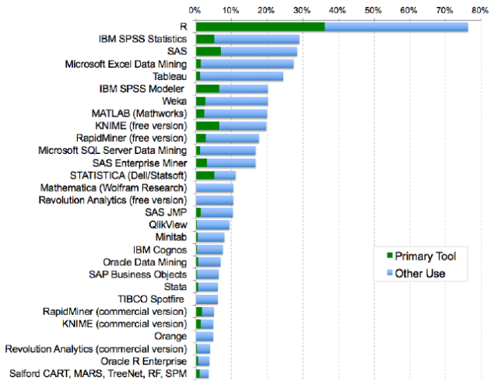
R as a Predictive Analytics Tool, part I
Source: 2015 Rexer Analytics Data Science Survey

Slide 13
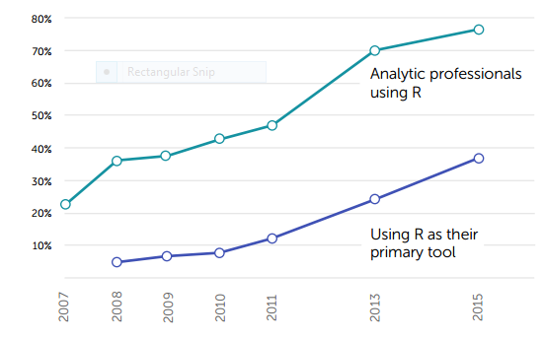
R as a Predictive Analytics Tool, part II
Source: 2015 Rexer Analytics Data Science Survey

Slide 14
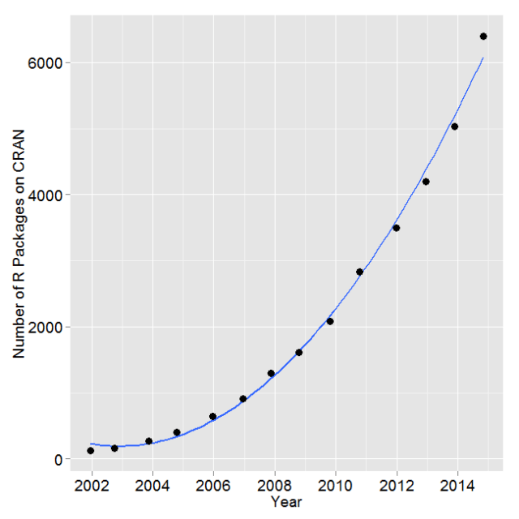
Exponential Growth of R Packages
Source: https://www.r-bloggers.com/on-the-growth-of-cran-packages/

Slide 15
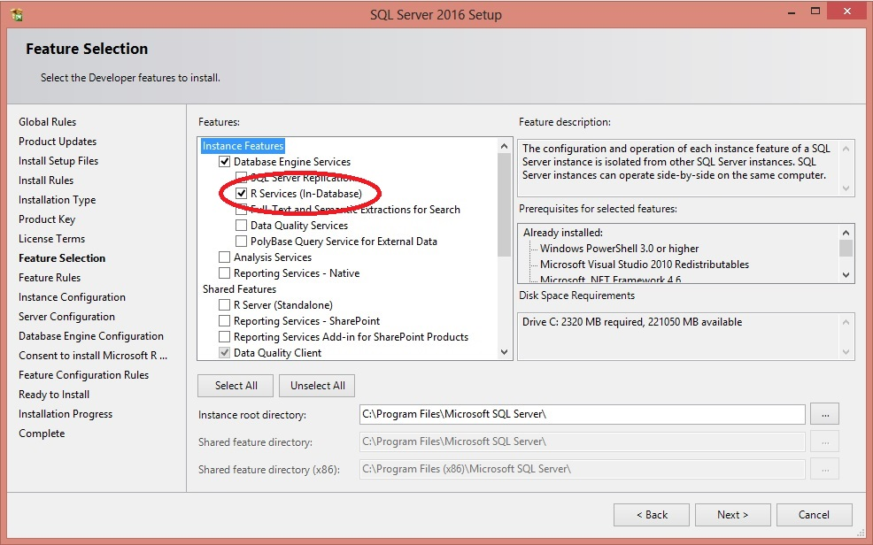
Install R Services (In-Database), part I

Slide 16
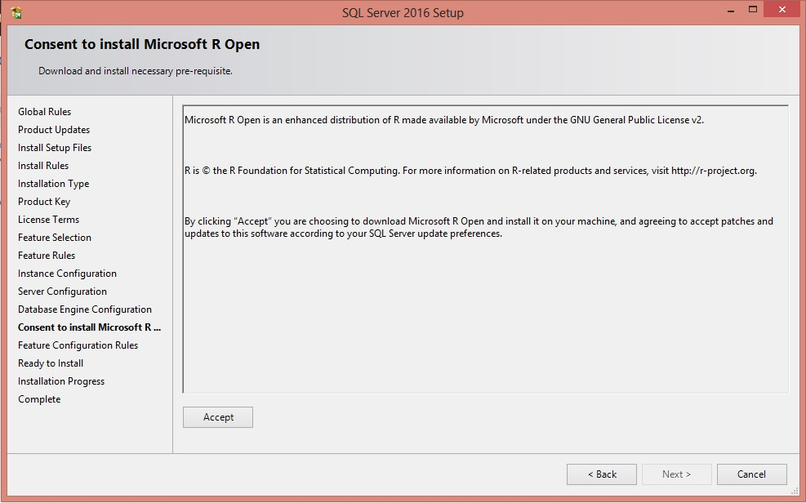
Install R Services (In-Database), part II

Slide 17
Post-Installation Configuration
Enable External Scripts:
EXEC sp_configure 'external scripts enabled', 1;
RECONFIGURE;
Configure Memory Appropriately

Slide 18
Basic Concepts of R, part I
The Assignment Operator: x <- 1
Sequences: 1:10 A:Z
Vectors: n <- 1:10; letters <- A:Z; x <- 1;
Combiner: fib <- c(1, 1, 2, 3, 5, 8, 13);
Data Frame:

Slide 19
Basic Concepts of R, part II
Vectorized Operation:
x <- 1:6;
y <- x + 3;
(4, 5, 6, 7, 8, 9)
x <- 1:6;
y <- 7:12;
z <- x + y;
(8, 10, 12, 14, 16, 18)
x <- 1:6;
y <- 7:9;
z <- x + y;
(8, 10, 12, 11, 13, 15)

Slide 20
Getting Data Into and Out of R
Demo #2

Slide 21







The Case Studies (Very Slightly Fictionalized)
My Fictional Hospital
MFH

Slide 22
Averting Panic Over a Charge Summary Report
Demo #3

Slide 23
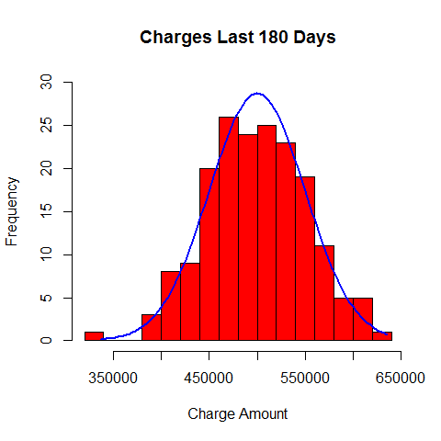
Distribution of Charges

Slide 24
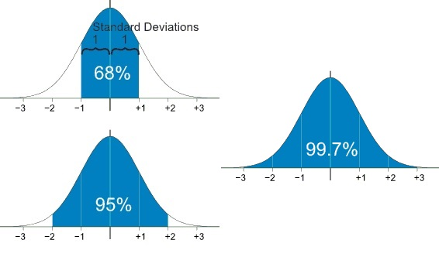
Reviewing Standard Normal Distribution
Source: https://www.mathsisfun.com/data/standard-normal-distribution.html

Slide 25
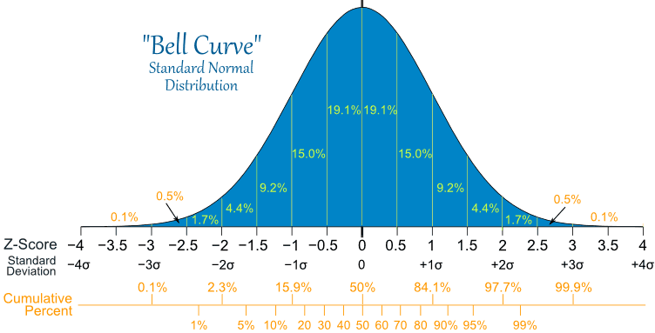
Standard Normal Distribution in Detail
Source: https://www.mathsisfun.com/data/standard-normal-distribution.html

Slide 26

Standard Normal Distribution in Detail
Source: https://www.mathsisfun.com/data/standard-deviation-calculator.html

Slide 27
Overbooking Without Over-Overbooking
Demo #4

Slide 28
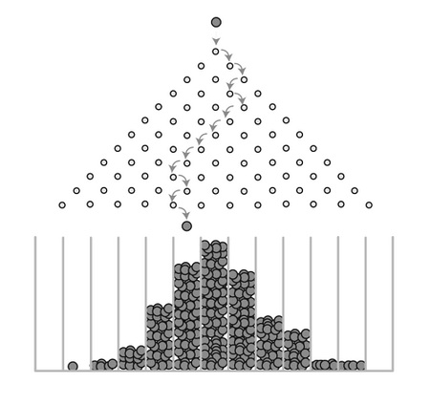
Galton Board

Slide 29
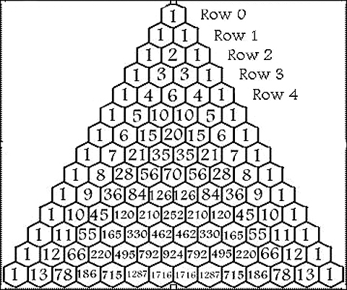
Pascal’s Triangle

Slide 30
Galton Board Binomial Distribution
Video

Slide 31
Resources and Next Steps
This Presentation:
https://github.com/DrJekyll325/SQLServer
Microsoft Data Exploration and Predictive Modeling Tutorial:
https://msdn.microsoft.com/en-us/library/mt591995.aspx
Coursera Data Science Specialization:
https://www.coursera.org/en-us/library/mt591995.aspx

Slide 32
Session Evaluations
ways to access
3
Your feedback is important and valuable.
Submit by 5pm
Friday November 6th to WIN prizes
Go to passSummit.com
Download the GuideBook App and search: PASS Summit 2016
Follow the QR code link displayed on session signage throughout the conference venue and in the program guide

Slide 33
Thank You
Learn more from
Chris Hyde
chrishyde325@gmail.com or follow @ChrisHyde325

